Slide 1
أكـــــاديميــــة طــــويـــق
Deep Learning

Slide 2
Reinforcement Learning Basics Understanding reward-based learning Deep Q-Networks (DQN) and Policy Gradient methods
By: Dr. Afshan Hashmi

Slide 3
Topics Covered:
What is Reinorcement Learning
Markov Decision Process
Exploration-Exploitation Trade-off
Understanding Reward-Based Learning
Deep Q-Networks
Policy Gradient Methods
Implementation of TIC TAC TOE Game with RL

Slide 4
What is Reinforcement Learning?
Reinforcement Learning (RL) is a type of machine learning where an agent learns by interacting with an environment and receiving rewards or penalties. The goal is to maximize cumulative reward over time.
Unlike supervised learning, where the model is trained on labeled data, RL learns from trial and error the agent tries different actions and improves over time based on feedback.
Real-Life Analogy
Imagine you're training a puppy to sit:
Every time the puppy sits when you say "Sit," you give it a treat (reward).
If it doesn't sit or jumps, you ignore it or gently say "No" (negative or no reward).
Over time, the puppy learns that sitting when it hears the command leads to treats, so it repeats that behavior.

Slide 5
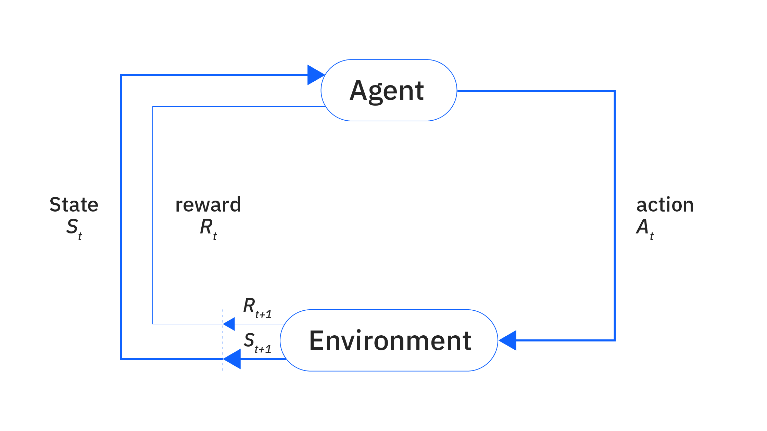
Markov Decision Process (MDP)
Reinforcement Learning fundamentally describes the interaction between an agent, its environment, and a defined goal. This relationship is widely formalized using the Markov Decision Process (MDP) framework.

Slide 6
Markov Decision Process (MDP)
Agent-Environment Interaction: An RL agent learns by continuously interacting with its environment.
State Information: The environment provides the agent with information about its current state.
Action Selection: Based on the current state, the agent determines which action(s) to take.
Reward Signal: If an action leads to a positive reward signal from the environment, the agent is encouraged to repeat that action when encountering similar future states.
Iterative Learning: This cycle of observing the state, taking an action, and receiving a reward (or punishment) repeats for every new state.
Goal Achievement: Over time, through these reward and punishment signals, the agent learns to select actions within the environment that lead to the achievement of a specified goal.
Key MDP Terminology:
State Space: Refers to all possible information that can be provided by an environment's state. It encompasses every observable aspect of the environment that the agent can perceive.
Action Space: Denotes all possible actions that the agent is permitted to take within any given state.

Slide 7
Exploration-Exploitation Trade-off
No Labeled Guidance: Unlike supervised learning, an RL agent lacks pre-labeled input data to guide its actions.
Need for Exploration: Consequently, the agent must explore its environment by trying new, untried actions to discover which ones yield rewards.
Learning from Rewards: From these reward signals, the agent learns to exploit its knowledge, preferring actions that have previously led to rewards to maximize its gains.
Continuous Exploration: However, the agent cannot solely exploit its current knowledge. It must also continue to explore new states and actions to discover potentially better rewards or more optimal action sequences.
The Dilemma: RL algorithms face a fundamental dilemma:
Exploration: Trying new things to discover more information and potentially higher rewards.
Exploitation: Using current best knowledge to maximize immediate rewards.
Balancing Act: The agent must continuously balance these two imperatives – trying novel actions while also leveraging previously rewarded actions to achieve the largest cumulative reward over time. Exclusively pursuing either exploration or exploitation will lead to suboptimal long-term performance.

Slide 8
Key Components of RL
Component | Explanation | Analogy (Puppy Example)
Agent | The learner or decision-maker. | The puppy
Environment | The world the agent interacts with. | The room or yard where the training happens
State (s) | The current situation the agent is in. | The puppy's position (standing, sitting)
Action (a) | The choice the agent makes. | Sit, jump, lie down
Reward (r) | Feedback signal (positive or negative) after taking an action. | Treat or no treat
Policy (π) | The strategy or rules the agent follows to choose actions. | "If I hear 'Sit', then sit down."
Value Function (V) | The long-term reward expected from a state (how good a state is in the long run). | "How valuable is being calm when asked?"
Q-Value (Q) | Expected reward for taking a specific action in a state, then following a policy after. | "If I sit now, how good is that decision for future rewards?"

Slide 9
Quick Example: Game of Tic-Tac-Toe
Agent: The RL model that learns to play.
Environment: The game board.
State: The current positions of Xs and Os.
Action: Putting an X in an empty square.
Reward: +1 for winning, -1 for losing, 0 for a draw.
Policy: Rules for choosing which square to mark next.
Value Function: How likely this game state will lead to a win.
Q-Value: Expected reward of placing an X in a particular spot at a particular time.

Slide 10
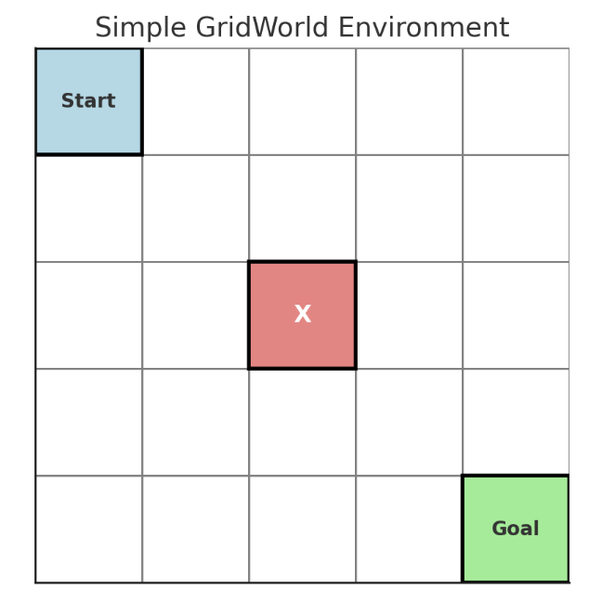
Quick Example: Game of Tic-Tac-Toe
How it relates to RL:
Agent: Starts at the blue cell labeled "Start".
Environment: The 5x5 grid.
State: Each cell in the grid is a possible state.
Action: The agent can move up, down, left, or right.
Reward:
+1 for reaching the green "Goal" cell.
-1 or 0 for stepping into an obstacle (red "X") or non-goal cell.
Policy (π): A strategy that tells the agent which direction to move in each state.
Value Function (V): Measures how good it is to be in a particular state (e.g., how close it is to the goal).
Q-Value (Q): Measures how good it is to take a particular action in a given state.

Slide 11
2. Understanding Reward-Based Learning
Reward-based learning is the fundamental principle of Reinforcement Learning (RL), where an agent learns optimal behavior through trial and error, guided by rewards from its environment.
Learning Mechanism: The agent learns by:
Exploring: Trying different, often new, actions to discover which ones yield positive reward signals. This is crucial for discovering effective strategies that might not be immediately obvious.
Exploiting: Leveraging its accumulated knowledge of previously rewarded actions to maximize its current gains. This means choosing actions that are known to lead to high rewards.
Key Concepts:
Reward Signal (r): This is the immediate scalar feedback received from the environment after taking an action. It directly guides the agent towards desirable behaviors. A positive reward encourages the action, while a negative reward (punishment) discourages it.
Delayed Rewards (Credit Assignment Problem): A significant challenge in RL is that the consequences (rewards) of an action might not be immediately apparent. An action taken now might only lead to a reward several steps later. The "credit assignment problem" refers to the challenge of determining which specific actions in a sequence were responsible for a delayed reward.

Slide 12
2. Understanding Reward-Based Learning
Discount Factor (γ):
Purpose: It's a value between 0 and 1 (inclusive) that determines the importance of future rewards relative to immediate rewards.
Interpretation:
γ=0: The agent is "myopic" and only considers immediate rewards.
γ=1: The agent values future rewards as much as immediate rewards (undiscounted).
0<γ<1: The agent values immediate rewards more, but still considers future rewards, with their value exponentially decaying over time.
Effect: A lower γ makes the agent focus on short-term gains, while a higher γ encourages long-term planning.
Bellman Equation (for Value Functions):
Purpose: The Bellman equation is a fundamental equation in dynamic programming and RL that defines the relationship between the value of a state and the values of its successor states. It essentially breaks down the long-term value problem into smaller, recursive parts.
Equation: V(s)=E[r+γV(s′)]
Explanation: The value (V(s)) of being in a particular state (s) is equal to the expected immediate reward (r)received from that state plus the discounted value (γV(s′)) of the next state (s′) that the agent transitions to. The expectation (E) is taken over all possible next states and rewards, considering the agent's policy and environment dynamics.

Slide 13
2. Understanding Reward-Based Learning
Temporal Difference (TD) Learning:
Purpose: TD learning is a model-free RL method that learns value functions directly from experience. It combines ideas from Monte Carlo methods (learning from experience/sampling) and Dynamic Programming (bootstrapping, i.e., updating estimates based on other learned estimates).
Equation: V(s)←V(s)+α[r+γV(s′)−V(s)]
Explanation: This is an update rule for the value function.
V(s)←V(s): The current estimated value of state s is updated.
α (alpha): The learning rate, a small positive number that determines how much the current estimate V(s)is adjusted based on the observed error.
[r+γV(s′)−V(s)]: This entire term is the Temporal Difference (TD) Error.
r+γV(s′): This is the target value or "TD target." It's an estimate of the value of state s based on the immediate reward (r) and the discounted estimated value of the next state (V(s′)).
−V(s): This is the current estimate of the value of state s.
The TD Error, therefore, represents the difference between the agent's current estimate of a state's value and a more "up-to-date" estimate (the TD target) derived from actual experience (immediate reward) and the estimated value of the next state. The agent adjusts its estimate V(s) in the direction of this error.

Slide 14
3. Deep Q-Networks (DQN)
DQN is a prominent value-based Reinforcement Learning (RL) method that revolutionized how RL
agents could tackle complex problems with high-dimensional state spaces (e.g., raw pixel images from Atari games). It achieves this by combining traditional Q-Learning with Deep Neural Networks.
Q-Learning Basics:
Goal: Q-Learning aims to learn the optimal Q-function (also known as the action-value function), denoted as Q(s,a). The Q(s,a) value represents the maximum expected future reward an agent can achieve by taking action ain state s and then following an optimal policy thereafter.
Update Rule: The core of Q-Learning involves iteratively updating the estimated Q-values based on observed rewards and future Q-values: Q(s,a)←Q(s,a)+α[r+γa′max​Q(s′,a′)−Q(s,a)] Where:
Q(s,a): The current estimated Q-value for taking action a in state s.
α: The learning rate, controlling the step size of updates.
r: The immediate reward received after taking action a in state s.
γ: The discount factor, valuing future rewards.
maxa′​Q(s′,a′): The maximum estimated Q-value for the next state s′ (representing the optimal action in the next state).
[r+γmaxa′​Q(s′,a′)−Q(s,a)]: This is the Temporal Difference (TD) error, indicating the discrepancy between the current Q-value estimate and a more informed estimate.

Slide 15
3. Deep Q-Networks (DQN)
DQN Enhancements:
DQN introduces two key mechanisms to stabilize and improve the training of deep Q-networks, which can be prone to instability due to using a neural network to approximate the Q-function:
Experience Replay:
Mechanism: Stores past transitions (s,a,r,s′) (state, action, reward, next state) in a large memory buffer.
Benefit: During training, it randomly samples mini-batches from this buffer. This breaks strong correlations between consecutive samples (which would occur if the network only learned from the immediate sequence of experiences) and increases data efficiency by allowing the network to learn from each experience multiple times.
Target Network:
Mechanism: Uses a separate, "target" Q-network (let's call it Qtarget​) which is a delayed, periodically updated copy of the main Q-network (Q).
Benefit: The target Q-values (r+γmaxa′​Qtarget​(s′,a′)) used for calculating the TD error are computed using this older, stable target network. This provides a more consistent target for the main Q-network to learn from, preventing oscillations and improving training stability. The target network's weights are typically updated to match the main Q-network's weights only every few thousand steps.

Slide 16
3. Deep Q-Networks (DQN)
Initialization: Initialize the main Q-network (e.g., Q) and the target network (Q_target) with the
same random weights.
Loop for each episode:
Observe State: Get the current state s.
Action Selection: Select an action a using an ϵ-greedy policy. This means with probability ϵ (exploration), a random action is chosen, and with probability (1−ϵ) (exploitation), the action with the highest Q-value from the current Q-network is chosen. ϵ usually decays over time.
Execute Action: Perform action a in the environment.
Observe Outcome: Receive reward r and the next state s′.
Store Transition: Store the observed transition (s,a,r,s′) in the experience replay buffer.
Sample Mini-batch: Randomly sample a mini-batch of transitions from the replay buffer.
Compute Target: For each transition in the mini-batch, compute the target Q-value y: y=r+γa′max​Qtarget​(s′,a′)
Update Q-network: Perform a gradient descent step to update the main Q-network's weights, minimizing the Mean Squared Error (MSE) loss between the predicted Q-value and the target Q-value: L=(y−Q(s,a))2
Update Target Network: Periodically (e.g., every few thousand steps), update the weights of the target network (Q_target) by copying the weights from the main Q-network (Q).

Slide 17
3. Deep Q-Networks (DQN)
Limitations of DQN:
Only Handles Discrete Actions: DQN is fundamentally designed for environments where the agent can choose from a finite, discrete set of actions. It cannot directly handle continuous action spaces.
Can Overestimate Q-values: Due to the use of the max operator in the target calculation, DQN can sometimes suffer from an overestimation bias in its Q-values. This is because the maximum value is taken over estimated Q-values, which might contain positive errors, leading to an overoptimistic assessment of future rewards.

Slide 18
4. Policy Gradient Methods
Unlike value-based methods such as DQN, policy gradient methods directly optimize the agent's policy (π) to maximize the expected cumulative rewards.
Key Idea:
The agent's policy is represented directly as a neural network, denoted as πθ​(a∣s). This network takes a state (s) as input and outputs a probability distribution over possible actions (a).
The goal is to adjust the network's parameters (θ) using gradient ascent on the expected reward. Instead of learning values of states or actions, we directly learn the best actions to take in a given state.
Objective Function:
The primary objective is to maximize the expected total return (sum of future rewards) that the agent receives by following its policy
πθ​: J(θ)=Eπθ​​[t∑​rt​]
Here, Eπθ​​ denotes the expectation of rewards when following the policy πθ​.

Slide 19
4. Policy Gradient Methods
Policy Gradient Theorem:
This fundamental theorem provides a tractable way to compute the gradient of the objective function with respect to the policy parameters (θ). It states that the gradient can be expressed as: ∇θ​J(θ)=Eπθ​​[∇θ​logπθ​(a∣s)⋅Qπ(s,a)]
Explanation: This formula tells us how to adjust the policy parameters. We increase the probability of actions that lead to high Q-values (Qπ(s,a), the expected return from state s after taking action a and following policy π), and decrease the probability of actions that lead to low Q-values.
∇θ​logπθ​(a∣s) indicates the direction to change parameters to make action a more likely in state s.
REINFORCE Algorithm (Monte Carlo Policy Gradient):
REINFORCE is one of the simplest policy gradient algorithms. It's a Monte Carlo method because it updates the policy only after completing an entire episode.
Steps:
Sample an entire episode (a sequence of states, actions, and rewards) by following the current policy πθ​.
For each step t in the episode, compute the return Gt​, which is the total discounted reward from that step until the end of the episode.
Update Policy: Adjust the policy parameters (θ) using the following rule: θ←θ+α∇θ​logπθ​(at​∣st​)⋅Gt​
Where α is the learning rate.

Slide 20
4. Policy Gradient Methods
Advantages Over DQN:
Handles Continuous Action Spaces: A major advantage is that policy gradient methods can naturally handle continuous action spaces (e.g., controlling a robot arm's angle), as the neural network can output continuous values or parameters of a continuous distribution over actions. DQN, by contrast, is limited to discrete actions.
Better Convergence Properties: In some complex environments, policy gradient methods can exhibit better convergence properties and are less prone to issues like overestimation bias compared to DQN.
Advanced Policy Gradient Methods:
Actor-Critic: Combines policy gradients (the "actor" learns the policy) with value functions (the "critic" estimates values) to reduce variance in gradient estimates, leading to more stable and efficient training.
Proximal Policy Optimization (PPO): A widely used and highly performant algorithm that improves stability by clipping policy updates, preventing them from becoming too large and destabilizing training.

Slide 21


Hands On Exercise
Click Here For The Implementation
https://drive.google.com/file/d/1eC9ZsF3NiHesR2CE-YxK90UUCnFbO5iT/view?usp=share_link

Slide 22
Books and References
"Neural Networks and Deep Learning" (Michael Nielsen)
Reinforcement Learning: An Introduction – Sutton & Barto
Goodfellow, I., Bengio, Y., & Courville, A. (2016). Deep Learning. MIT Press.
Chollet, F. (2017). Deep Learning with Python. Manning Publications.
Hochreiter, S., & Schmidhuber, J. (1997). Long Short-Term Memory. Neural Computation.

Slide 23

















الشراكات العالمية

Slide 24
شــــــكــــرًا لكــــــم
THANK YOU

